Slide 1
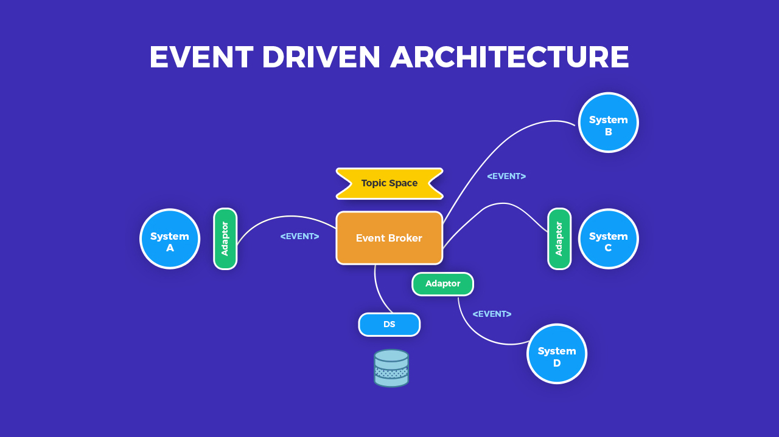
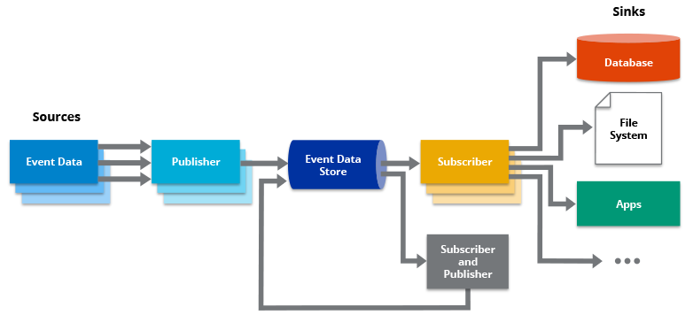

Slide 2
What is Software Architecture?
Architecture serves as a blueprint for a system. It provides an abstraction to manage the system complexity and establish a communication and coordination mechanism among components.
It defines a structured solution to meet all the technical and operational requirements, while optimizing the common quality attributes like performance and security.
These Architecture decisions includes −
Selection of structural elements and their interfaces by which the system is composed.
Behavior as specified in collaborations among those elements.
Composition of these structural and behavioral elements into large subsystem.
Architectural decisions align with business objectives.

Slide 3
Event Driven Architecture
An event-driven architecture consists of event producers that generate a stream of events, and event consumers that listen for the events.
The event-driven architecture helps manage this by building a central unit that accepts all data and then delegates it to the separate modules that handle the particular type. This handoff is said to generate an “event,” and it is delegated to the code assigned to that type.
Suitable for Use case:
Asynchronous systems with asynchronous data flow
IOT applications
Healthcare
Online Banking

Slide 4
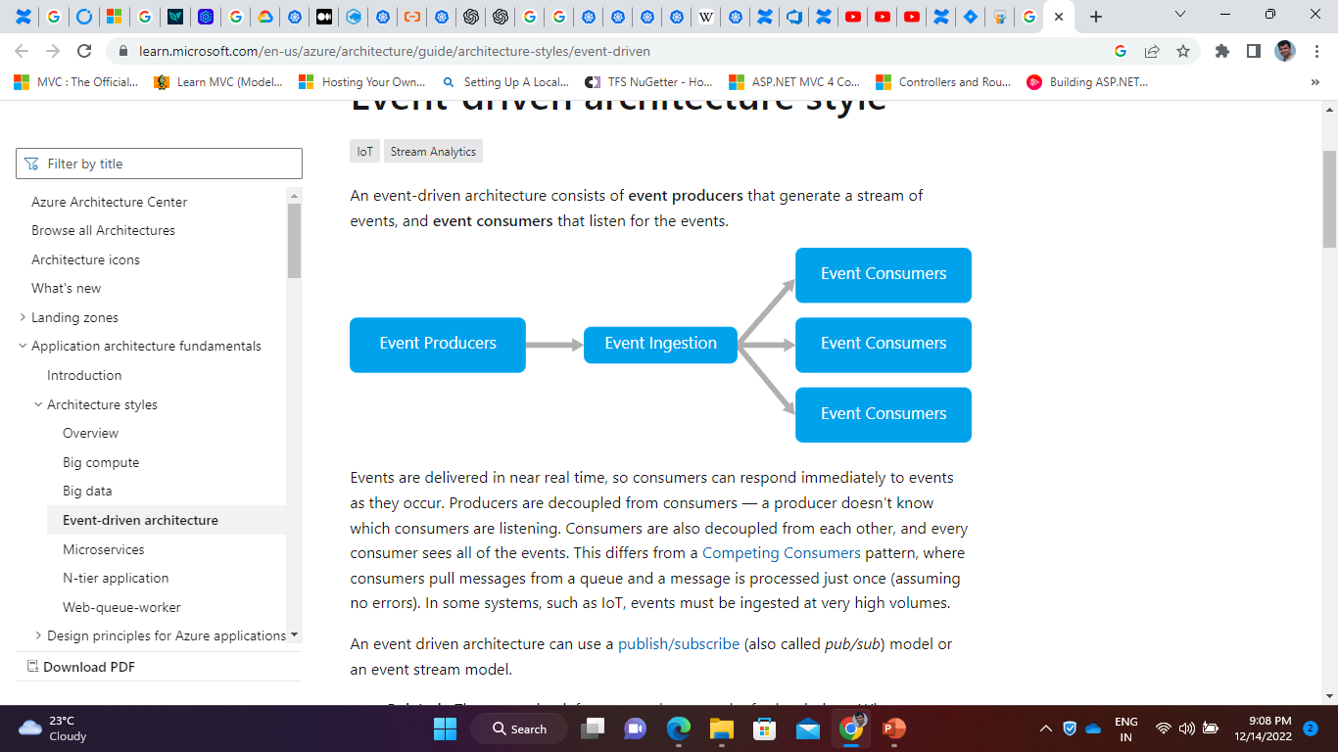

Slide 5
Event Driven Architecture
Event-driven architecture is a design model that connects distributed software systems and allows for efficient communication. EDA makes it possible to exchange information in real time or near real time. It is common in designing apps that rely on microservices (when every service runs its own process.).
Publish/subscribe is a flexible messaging pattern that allows disparate system components to interact with one another asynchronously.

Slide 6
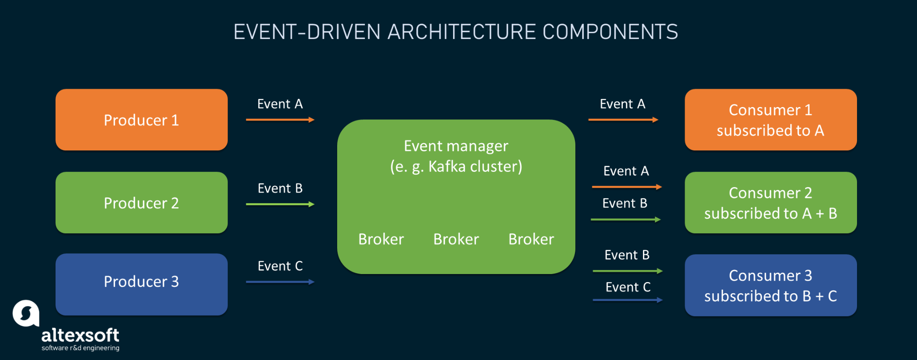

Slide 7
An event driven architecture can use -
Pub/Sub Model: The messaging infrastructure keeps track of subscriptions. When an event is published, it sends the event to each subscriber. After an event is received, it cannot be replayed, and new subscribers do not see the event.
Event streaming Model: Events are written to a log. Events are strictly ordered (within a partition) and durable. Clients don't subscribe to the stream, instead a client can read from any part of the stream. The client is responsible for advancing its position in the stream. That means a client can join at any time, and can replay events.

Slide 8
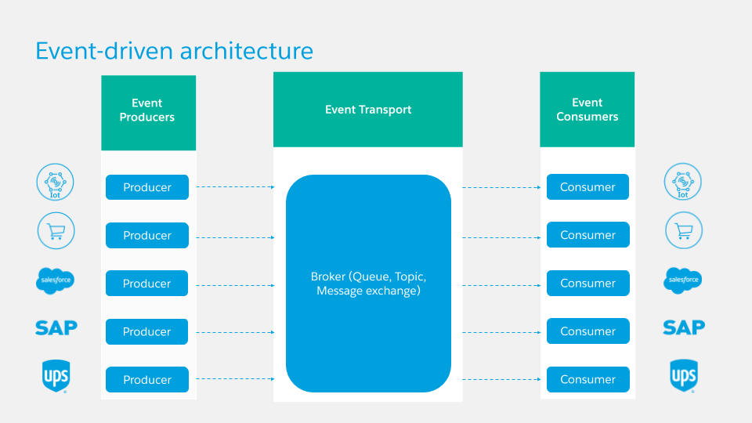

Slide 9
Event Driven Architecture
An event is a state change or an update within the system that triggers the action of other systems. It can be anything from a transaction and sensor input to a mouse click and a photo upload, etc. Events may vary in complexity and size and originate from both internal and external sources.

Slide 10
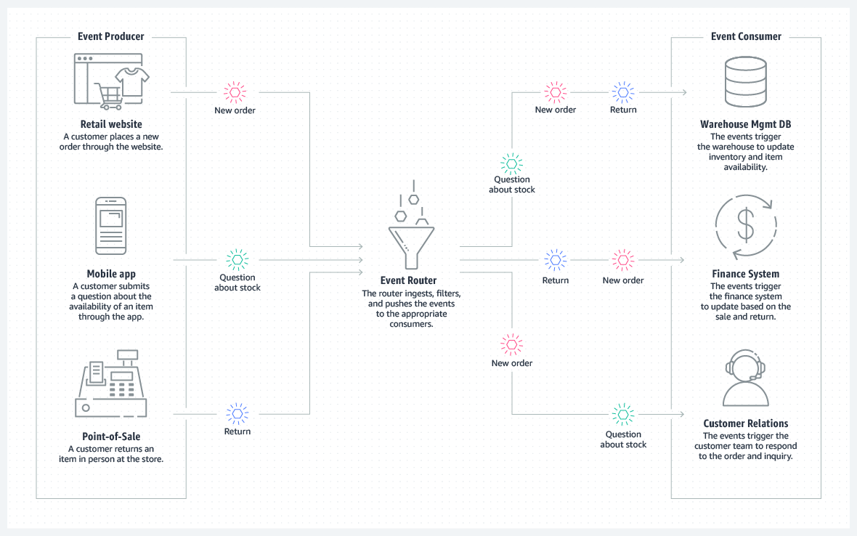

Slide 11
When to use this architecture
Multiple subsystems must process the same events.
Real-time processing with minimum time lag.
Complex event processing, such as pattern matching or aggregation over time windows.
High volume and high velocity of data, such as IoT.

Slide 12
Event Based Architecture
Event-based architectures usually comprise three core components:
event producers that generate or detect events and transmit them to event managers;
event managers that act as middleware and are responsible for asynchronous filtering, processing, and routing of received events; and
event consumers that receive events and act on them.

Slide 14
Principles of Event Driven Architecture
Scalability. EDAs allow for great horizontal scalability as one event may trigger responses from multiple systems with different needs and providing different results.
Loose coupling. Producers and consumers are unaware of each other. There is an intermediary that receives events, processes them, and sends them to the systems interested in specific events. This allows for loose coupling of services and facilitates their modifying, testing, and deployment. And unlike point-to-point system integrations, components can be easily added to or removed from a system.

Slide 15
Principles of Event Driven Architecture
Asynchronous eventing. Event notifications are broadcast asynchronously, meaning events are published as they happen. A service can consume or process a published event later if it’s unavailable. And it doesn’t affect or block a producing service.
Fault tolerance. Owing to systems being loosely coupled, the failure of one won’t make any difference to the working of other systems.

Slide 16
Benefits of this Architecture
Producers and consumers are decoupled.
No point-to-point integrations. It's easy to add new consumers to the system.
Consumers can respond to events immediately as they arrive.
Highly scalable and distributed.
Subsystems have independent views of the event stream.

Slide 17
Challenges of EDA
Guaranteed delivery. In some systems, especially in IoT scenarios, it's crucial to guarantee that events are delivered.
Processing events in order or exactly once. Each consumer type typically runs in multiple instances, for resiliency and scalability. This can create a challenge if the events must be processed in order (within a consumer type), or if the processing logic is not idempotent.

Slide 18
Tools used for EDA
ActiveMQ is a flexible, open-source message broker presented by Apache Software Foundation. It provides the functionality of the pub/sub messaging through topics between multiple producers and consumers. ActiveMQ is relatively easy to deploy in complex structures; the system shows high throughput and great reliability.
Redis is an open-source, in-memory data structure store used as a message broker and a database. Redis is also a popular choice for pub/sub applications, enabling processing millions of requests.

Slide 19
Tools used for EDA
Apache Kafka is the heavyweight in the world of distributed data streaming. The open-source platform allows for publishing, storing, processing, and getting subscribed to the streams of events in real time. Kafka provides its pub/sub functionality in a highly scalable, fault-tolerant, and secure fashion, allowing for handling trillions of events a day. Besides, it can be deployed on-premises and in the cloud.
Pulsar is another Apache family system for distributed publish/subscribe messaging. Initially designed as a message queuing system, Pulsar has added event streaming functionality in recent releases. Highly scalable, the system isolates producing and consuming operations and allows for flexible messaging models.

Slide 20
THANK YOU
Like the Video and Subscribe the Channel

